Slide 1
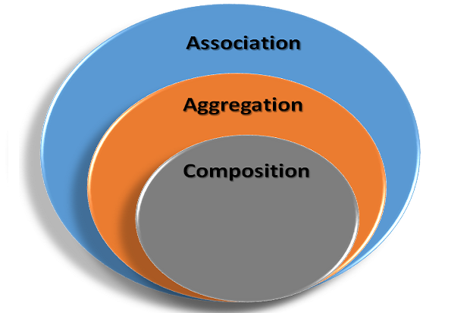

Slide 2
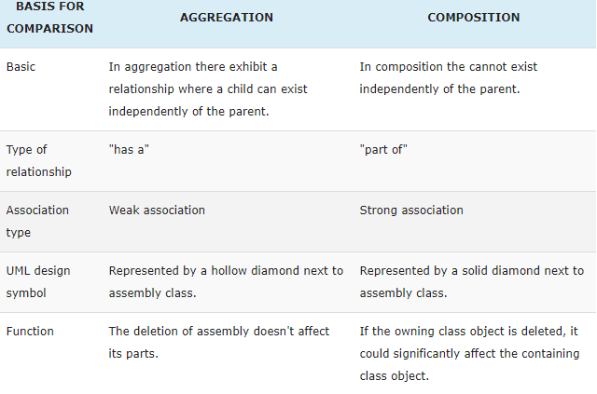

Slide 3
Manager used a swipe card to enter the company premises
Manager has many workers working under his supervision
Manager salary is totally dependent on project success.

